Slide 1



Landslide Prediction Using Machine Learning Models: A Comparative Study of Decision Tree, Gradient Boosting, Random Forest, and Support Vector Machine
Machine Learning [C]
Course Teacher: Prof. Dr. Md. Asraf Ali

Slide 2

About the presentation team
NOSHIN FARZANA [21-44647-1​]
AVIJIT SAHA ANTO[21-44630-1​]
SHAKIL KHAN [21-45118-2​]
GROUP Members

Slide 3

Table of contents
Introduction
Objective
Problem statement
Dataset
Methodology
Block Diagram
Result
Conclusion
Future works

Slide 4

INTRODUCTION
Landslides are one of the most destructive natural hazards, causing significant damage to infrastructure, the environment, and loss of life globally.
Accurate prediction and susceptibility mapping are critical for disaster mitigation, planning, and risk management in landslide-prone regions.
Machine Learning (ML) techniques have emerged as powerful tools for analyzing complex, non-linear geospatial data, enhancing the ability to predict landslide occurrences.
Compare four widely used ML models—Decision Tree (DT), Gradient Boosting (GB), Random Forest (RF), and Support Vector Machine (SVM)—to evaluate their effectiveness in landslide prediction.

Slide 5


Objective
To evaluate and compare the effectiveness of four machine learning models—Decision Tree (DT), Gradient Boosting (GB), Random Forest (RF), and Support Vector Machine (SVM)—in predicting landslide susceptibility.
To identify which model provides the highest accuracy and most reliable results for landslide prediction.
To understand the strengths and limitations of each model.

Slide 6

Problem statement
Landslides pose a serious threat to both natural and human-made environments, with significant socio-economic impacts.
Traditional prediction methods rely on statistical and empirical models, which often struggle to capture the complex, non-linear patterns in landslide data.
Availability of geospatial and environmental data, there is a need for advanced, reliable machine learning models that can accurately predict landslide susceptibility.

Slide 7
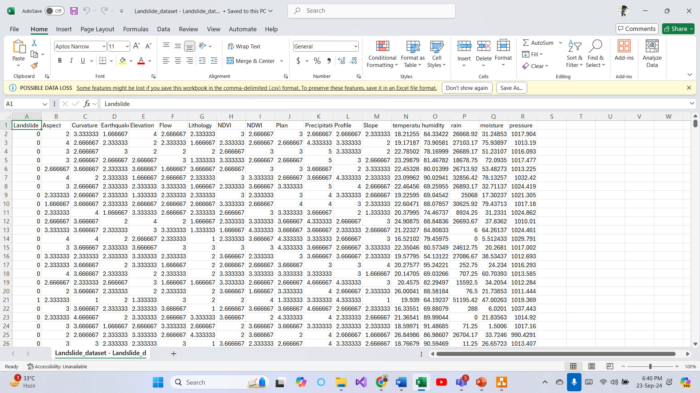

DATASET
Dataset Link: https://www.kaggle.com/datasets/vigneshwarchandran/landslide-data-large-numeric

Slide 8

Methodology
Data Collection
From Kaggle: https://www.kaggle.com/datasets/vigneshwarchandran/landslide-data-large-numeric
Data Cleaning
Clean and preprocess the data by handling missing values.
Data Visualization
Precipitation, Slope, and Elevation are distributed in the dataset, with different colors representing whether a landslide occurred or not. Correlation heatmap was generated to visualize the pairwise correlations between the features in the dataset.
Pre-Processing
Undersampling
Split the dataset into training and testing subsets (80% training, 20% testing).

Slide 9
Methodology contd.
Model Training
Train each model using the training dataset, optimizing hyperparameters through cross-validation.
Model Evaluation
Evaluate model performance using metrics such as Accuracy, Precision, Recall, and F1-score, Confusion Matrix on the test dataset.
Comparison and Analysis
Compare the models based on evaluation metrics and analyze the strengths and weaknesses of each model for landslide prediction.
Decision Tree (DT)
Gradient Boosting (GB)
Random Forest (RF)
Support Vector Machine (SVM)

Slide 10

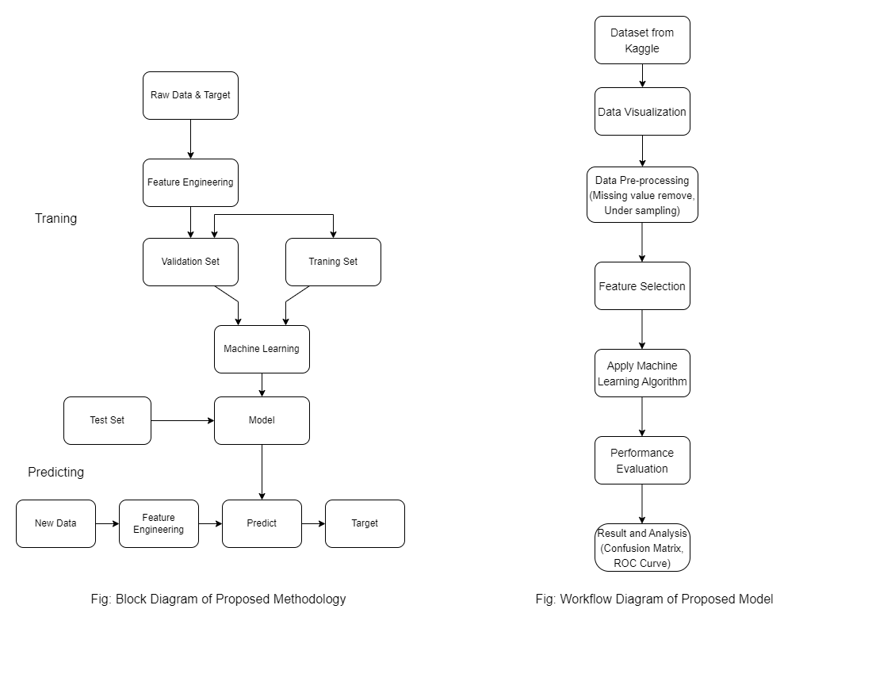
Block diagram

Slide 11

result
 | Accuracy | Precision | Recall | F1-score
Decision Tree | 0.9846449136276392 | 0.9809670781893004 | 0.981977342945417 | 0.9814719505918682
Gradient Boosting | 0.9971711456859972 | 0.984970477724101 | 0.95822454308094 | 0.9714134462678665
Random Forest | 0.9899765408402644 | 0.9846547314578005 | 0.9912461380020597 | 0.9879394405953296
Support Vector Machine | 0.9908296011942845 | 0.9861751152073732 | 0.9917610710607621 | 0.9889602053915275

Slide 12

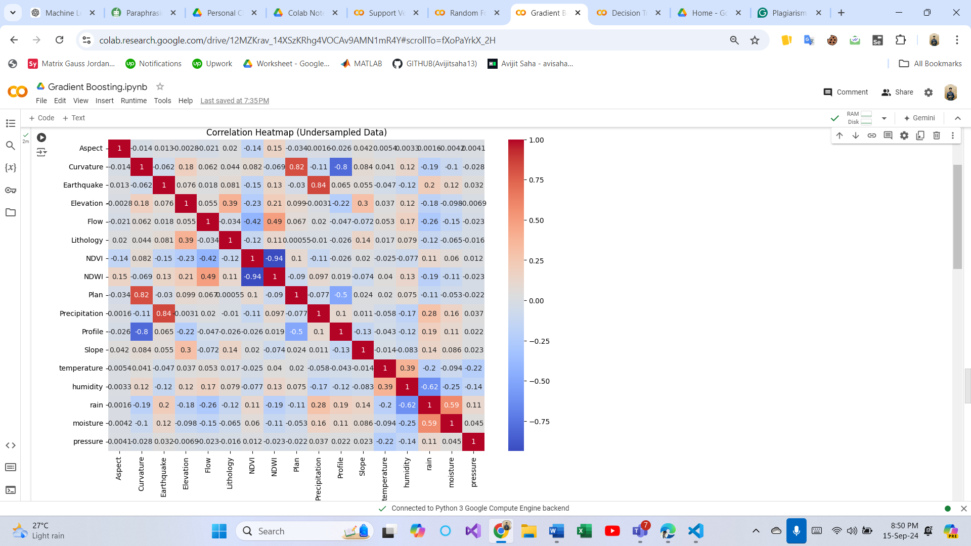

Result contd.
Figure: Data Visualization
Figure: Correlation Heat Map (Gradient Boosting)
Figure: Undersampling

Slide 13
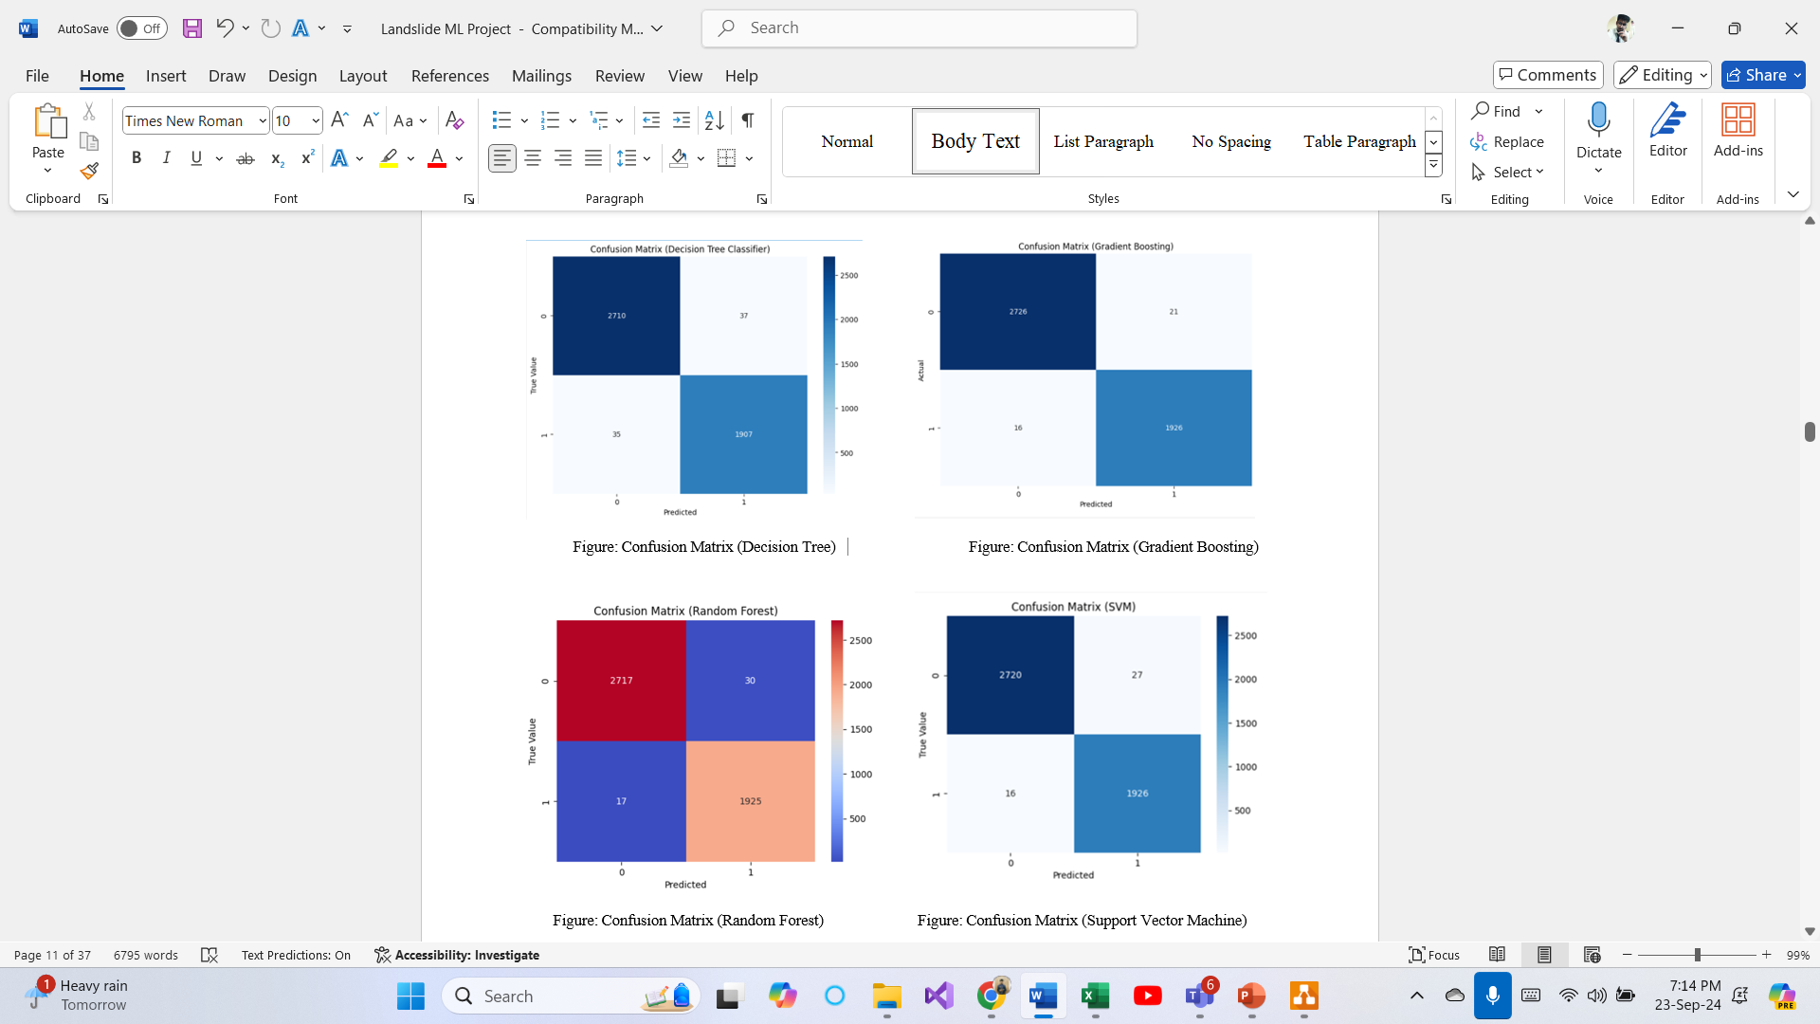
Result contd.

Slide 14
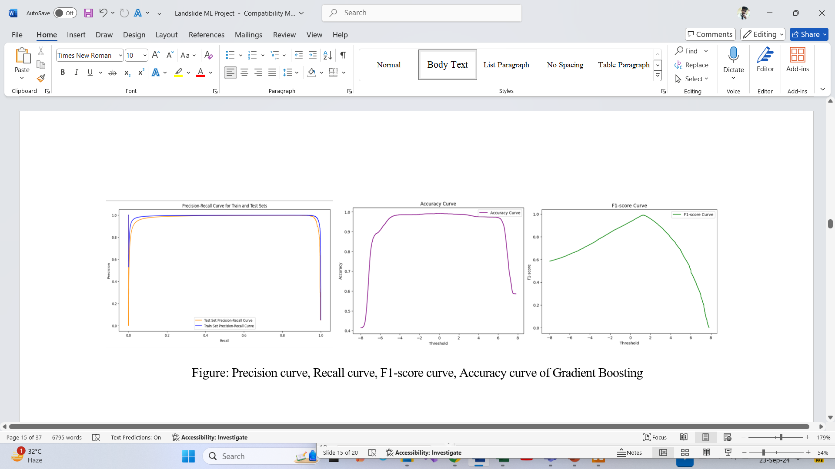
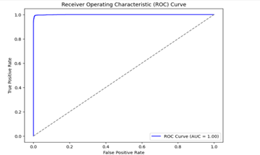
Result contd.
Figure: Precision curve, Recall curve, F1-score curve, Accuracy curve, ROC Curve of Gradient Boosting

Slide 15


conclusion
In this comparative study of machine learning models for landslide prediction, four popular algorithms were tested: Decision Tree, Gradient Boosting, Random Forest, and Support Vector Machine. Gradient Boosting outperformed other methods in correctly classifying landslide data, with an accuracy of 99 %.

Slide 16

Future works
Feature Engineering: Future research could focus on feature engineering to improve model performance. Additional features, such as weather conditions, soil moisture levels, and topographic factors, may improve prediction accuracy.
Model Optimization: While Gradient Boosting performed well, there is still room for hyperparameter optimization and fine-tuning to improve predictive accuracy and lower computational costs.
Ensemble Learning: Given the power of ensemble models such as Gradient Boosting and Random Forest, future research could look into stacking multiple algorithms or developing hybrid models to capture the strengths of each approach and make even more accurate predictions.
Real-Time Prediction: Using these models in real-time systems for landslide-prone areas could provide practical benefits, such as continuous monitoring and immediate action in the event of an impending landslide.
Dataset Expansion: Future research could include more diverse landslide events from different geographical regions. This would improve the model's ability to generalize and perform on previously unseen data.

Slide 17
REFERENCES
B. T. Pham, D. T. Bui, and I. Prakash, "Landslide susceptibility modelling using different advanced decision trees methods," Civil Engineering and Environmental Systems, published online, vol. 36, no. 1, pp. 1-17, Jan. 2019. [Online]. Available: https://doi.org/10.1080/10286608.2019.1568418.
J. Dou, A. P. Yunus, D. T. Bui, A. Merghadi, M. Sahana, Z. Zhu, C.-W. Chen, Z. Han, and B. T. Pham, "Improved landslide assessment using support vector machine with bagging, boosting, and stacking ensemble machine learning framework in a mountainous watershed, Japan," Landslides, vol. 16, no. 12, pp. 1-14, 2019. [Online]. Available: https://doi.org/10.1007/s10346-019-01286-5.
B. T. Pham, I. Prakash, K. Khosravi, K. Chapi, P. T. Trinh, T. Q. Ngo, S. V. Hosseini, and D. T. Bui, "A comparison of support vector machines and Bayesian algorithms for landslide susceptibility modeling," Geocarto International, vol. 34, no. 9, pp. 1-15, 2018. [Online]. Available: https://doi.org/10.1080/10106049.2018.1489422.
S. Ma, J. Chen, S. Wu, and Y. Li, "Landslide susceptibility prediction using machine learning methods: A case study of landslides in the Yinghu Lake Basin in Shaanxi," Sustainability, vol. 13, no. 1, pp. 1-17, 2021. [Online]. Available: https://doi.org/10.3390/su13010123.
C. Ballabio and S. Sterlacchini, "Support vector machines for landslide susceptibility mapping: The Staffora River Basin case study, Italy," Math. Geosci., vol. 44, no. 1, pp. 47-70, 2012. [Online]. Available: https://doi.org/10.1007/s11004-011-9379-9.
Y. Song, D. Yang, W. Wu, X. Zhang, J. Zhou, Z. Tian, C. Wang, and Y. Song, "Evaluating landslide susceptibility using sampling methodology and multiple machine learning models," Int. J. Geo-Inf., vol. 9, no. 2, pp. 1-25, 2020. [Online]. Available: https://doi.org/10.3390/ijgi9020074.
H. Wang, L. Zhang, K. Yin, H. Luo, and J. Li, "Landslide identification using machine learning," Geoscience Frontiers, vol. 12, pp. 351–364, 2021. https://doi.org/10.1016/j.gsf.2020.09.019.
F. Catani, D. Lagomarsino, S. Segoni, and V. Tofani, "Landslide susceptibility estimation by random forests technique: sensitivity and scaling issues," Nat. Hazards Earth Syst. Sci., vol. 13, no. 11, pp. 2815-2831, Nov. 2013. https://doi.org/10.5194/nhess-13-2815-2013.
S. Lee, "Application of logistic regression model and its validation for landslide susceptibility mapping using GIS and remote sensing data," Int. J. Remote Sens., vol. 26, no. 7, pp. 1477–1491, Apr. 2005. https://doi.org/10.1080/01431160512331331012.

Slide 18


Thank you

